Slide 1
Analysis of waves near the magnetopause during a period of FLR activity recorded by the Sanae radar
J A E Stephenson & A D M Walker
School of Physics
University of KwaZulu-Natal
(stephens@ukzn.ac.za)

Slide 2
Setting the scene (Part 1)
We are continuing our study of the excitation of Pc5 oscillations in the solar wind driving field line resonances observed by SuperDARN radars
Here we extend our study to the magnetosheath
We present simultaneous observations of data from Cluster 4 and the Sanae radar of oscillations at 2.1 mHz.
Our objective – not yet achieved – is ultimately to follow the propagation of such MHD waves, from the solar wind, through the magnetosheath, to the resonant field line so as to understand the mechanism of energy transfer in detail.

Slide 3
Setting the scene (Part 2)
The nature of the driving mechanism of FLRs is an important question in pulsation physics. Different mechanisms may operate at different times.
One mechanism is the Kelvin-Helmholtz instabilty on the magnetopause, excited by the solar wind. The can penetrate the magnetopause and travel as an evanescent fast wave in the magnetosphere. This wave then in turn excites a FLR. This does not explain discrete frequencies.
Cavity modes explain discrete frequencies but long-lived pulsations (many hours) require the cavity to be stable .
Previously (SD 2009,2010) we have presented evidence that FLRs can be driven by a coherent MHD wave in the solar wind. The wave of the appropriate frequency can leak into the waveguide (better analogy than cavity) and then excite a FLR.

Slide 4
Earlier result: 07 June 2000
Top panel: MHD energy flux in solar wind together with amplitude of analytic signals of two velocity components
Middle panel: Energy flux into ionosphere and amplitude of Doppler analytic signal
Bottom panel: Phase differences
Figure published in
Ann. Geophys., 28, 47-59, 2010
together with figure demonstrating amplitude coherence of better than 97%

Slide 5
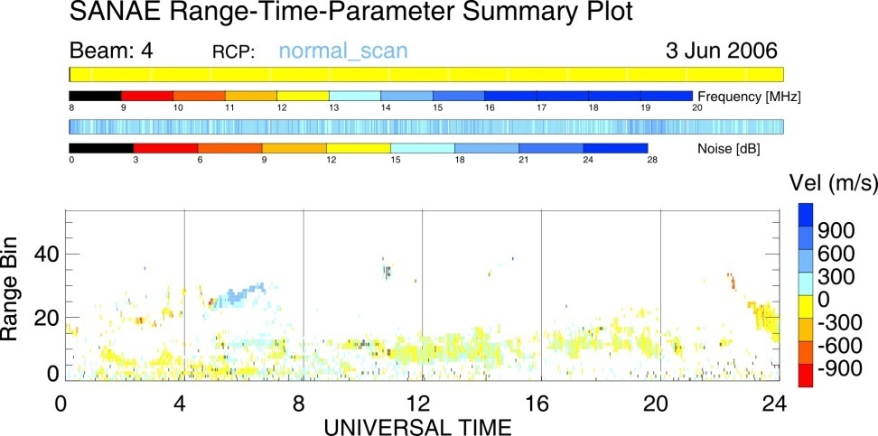
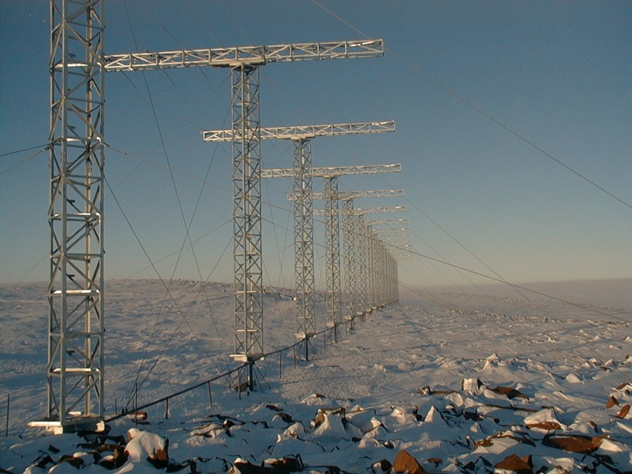
Doppler velocity in Sanae Beam 4
Event of 03 June 2006 (10:00-20:00 UT)
Pulsations evident as alternating positive and negative bands in Doppler velocity
Beam 4 (of 16) selected, most closely aligned with lines of magnetic latitude

Slide 6
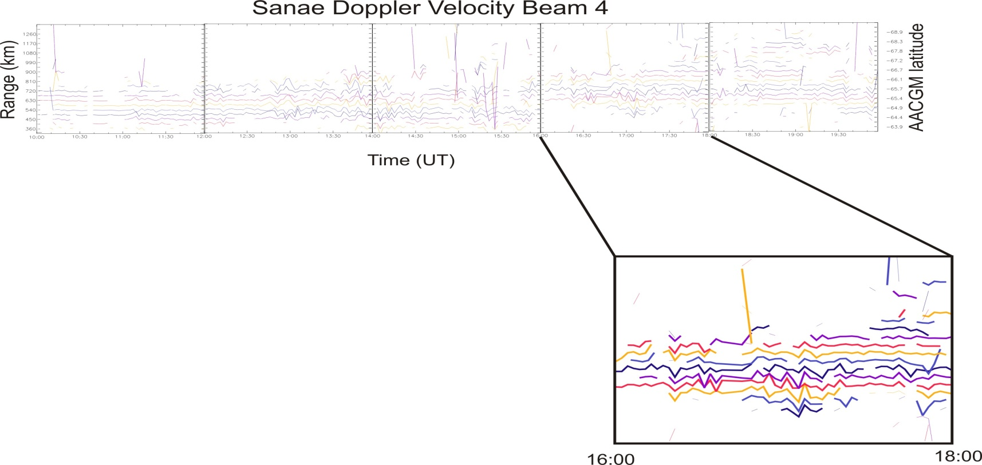
03 June 2006
Period of maximum 2.1 mHz pulsation activity
Range gate 10 (65.4⁰S AACGM) selected
10 hour event

Slide 7
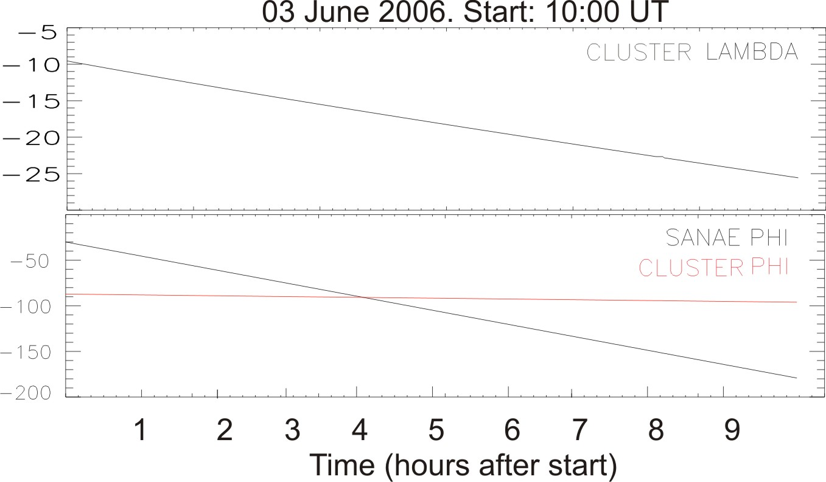
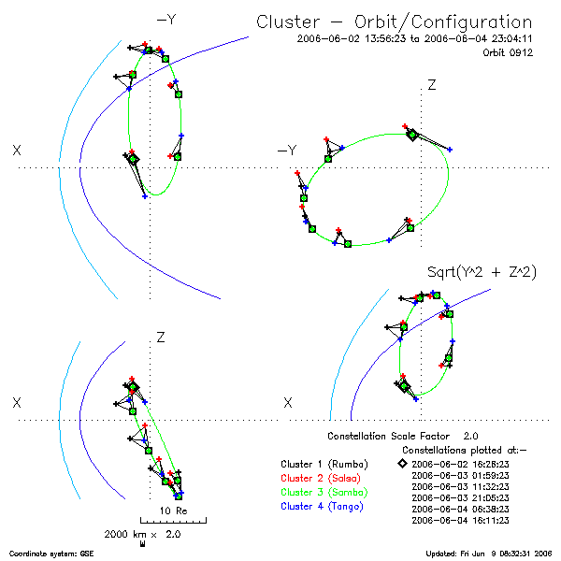
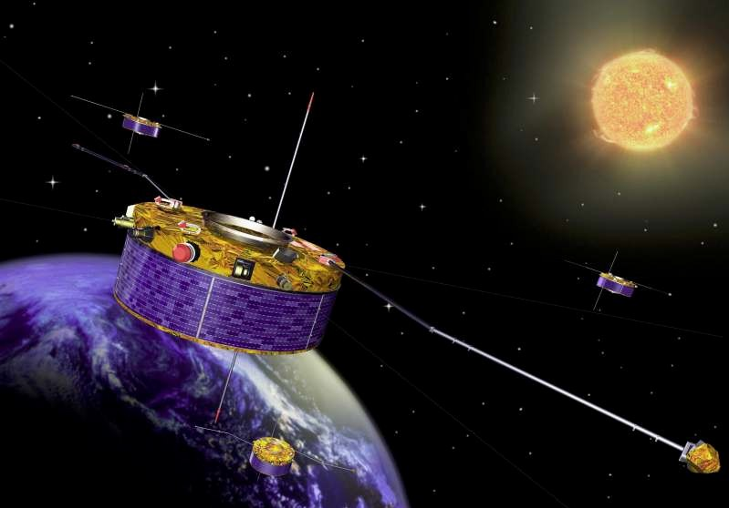

Slide 8
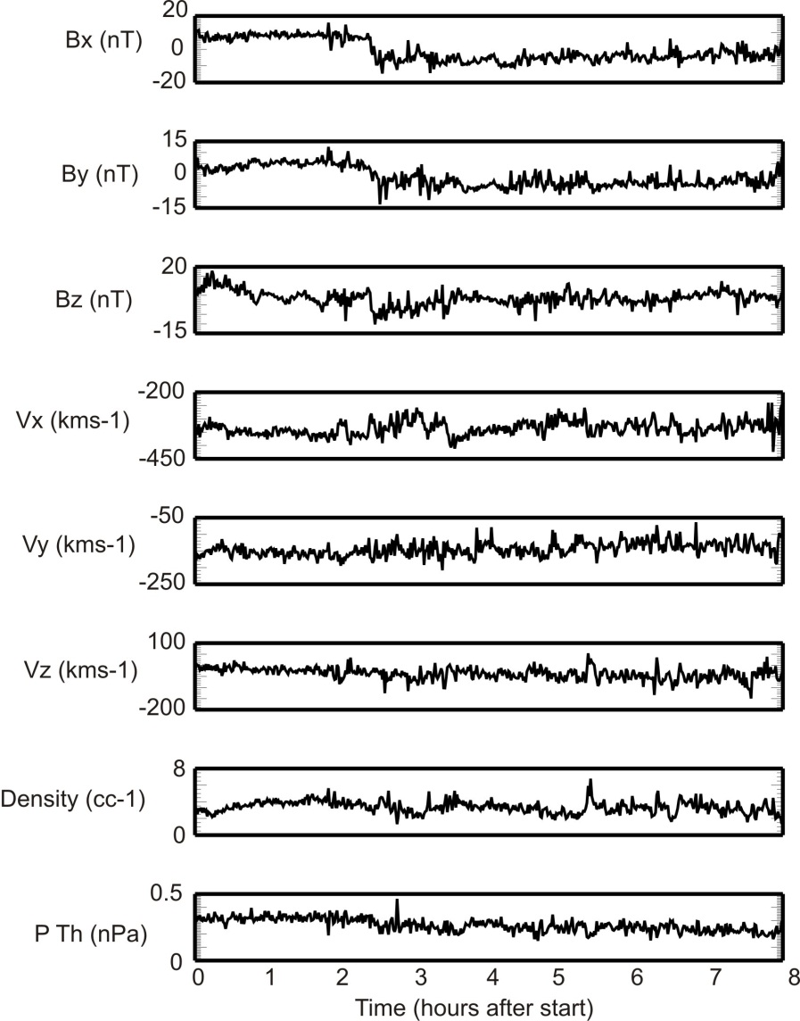
CLUSTER 4 raw data (GSE)
Start time 10:00 UT
indicate 2.1 mHz
resonance present
Step in data accounted
for when calculating
background field
Hanover, May/June 2011

Slide 9
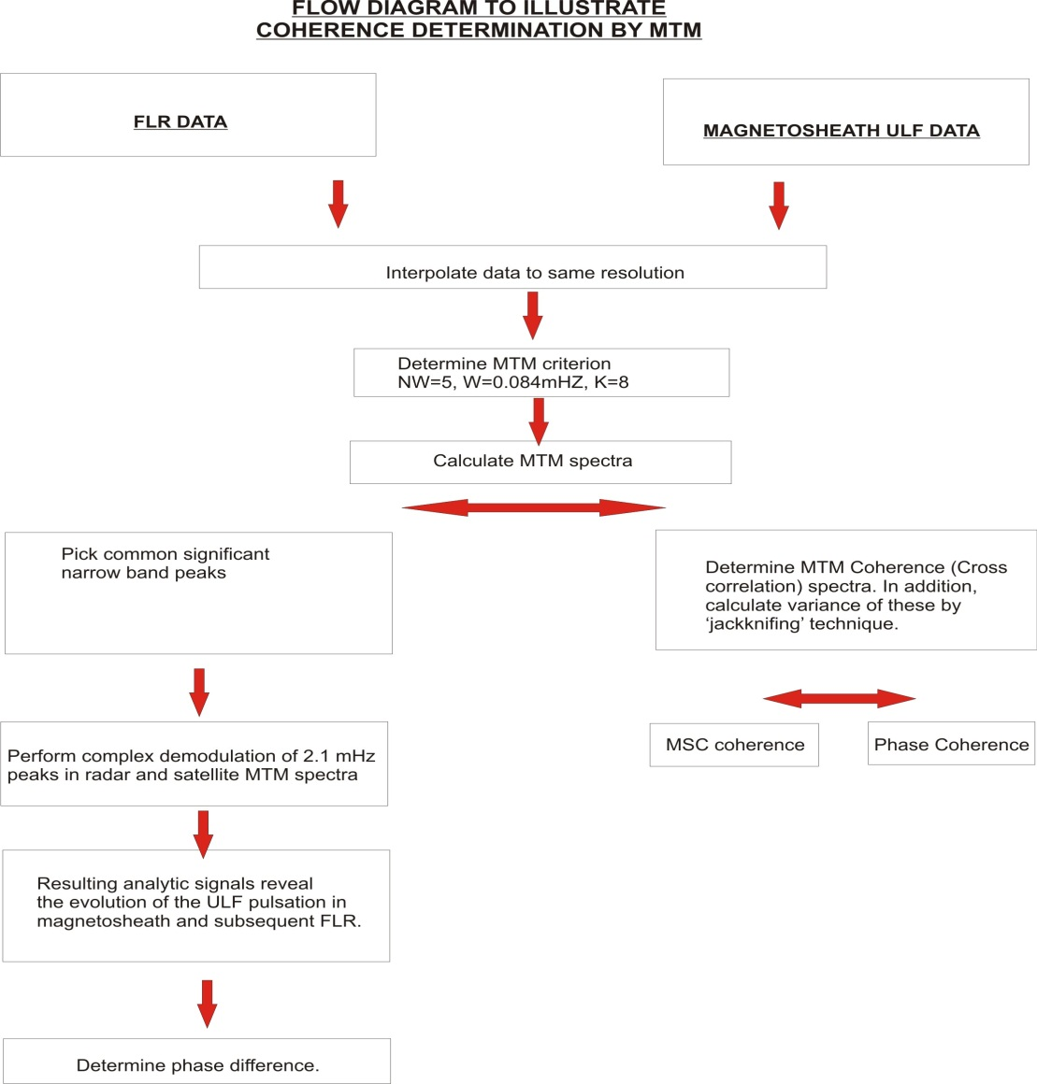
Analysis Procedures
Hanover, May/June 2011
Notes:
9

Slide 10
Multi-Taper (Window) Method
This method is used to reduce bias due to leakage and to recover lost information that would occur with a single taper.
Number of tapers with potentially good bias properties determined by k = 2NWΔt – 1
Reasonable choice of W=0.08 mHz must take into account trade-off between leakage and variance.
Allows for determination of confidence levels against a null hypothesis of a noisy spectrum
In addition, the variance of the spectrum can be calculated by jack-knifing, which is achieved by deleting each window in turn from the analysis
Hanover, May/June 2011
Notes:
10

Slide 11
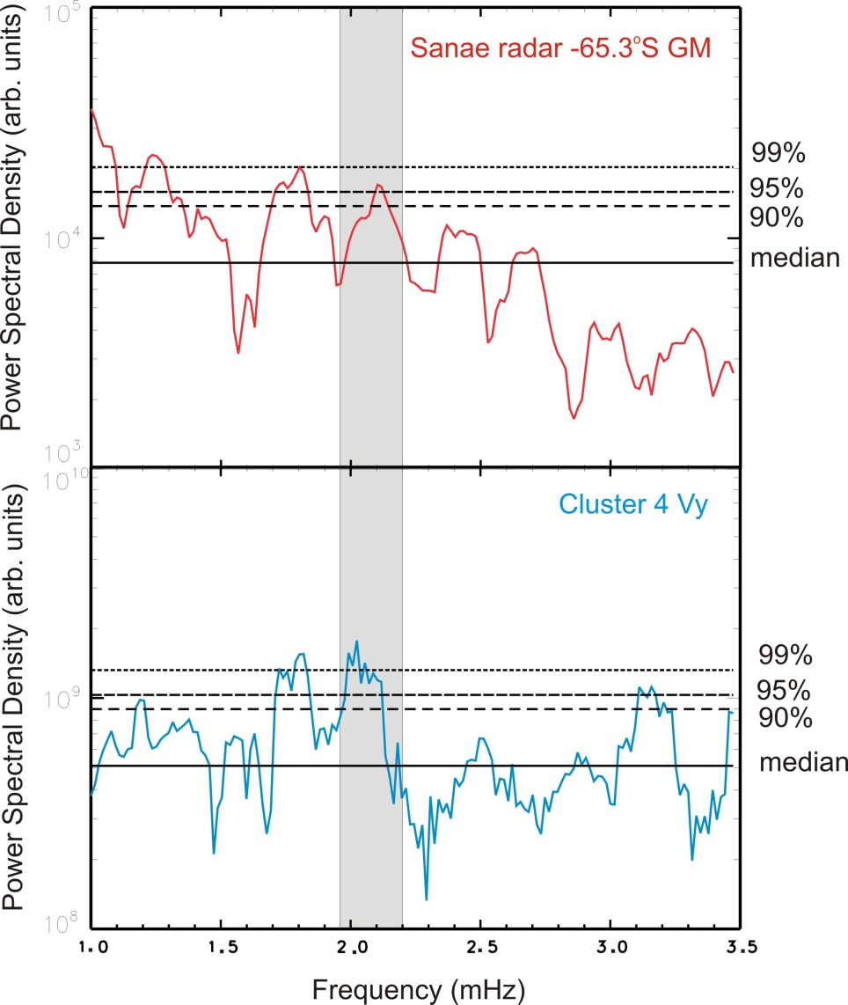
MTM Spectra of
Sanae Radar (Beam 4) and Cluster 4 V_{y} component
5 Tapers used
W (half width) =0.084mHz
2.1 mHz peak above 95% significance in radar spectrum
2.1 mHz peak above 99% significance in Cluster Vy
Common narrowband peaks near 2.1 mHz are shaded. Shading indicates width of peaks (2W) used for complex demodulation.
Hanover, May/June 2011

Slide 12
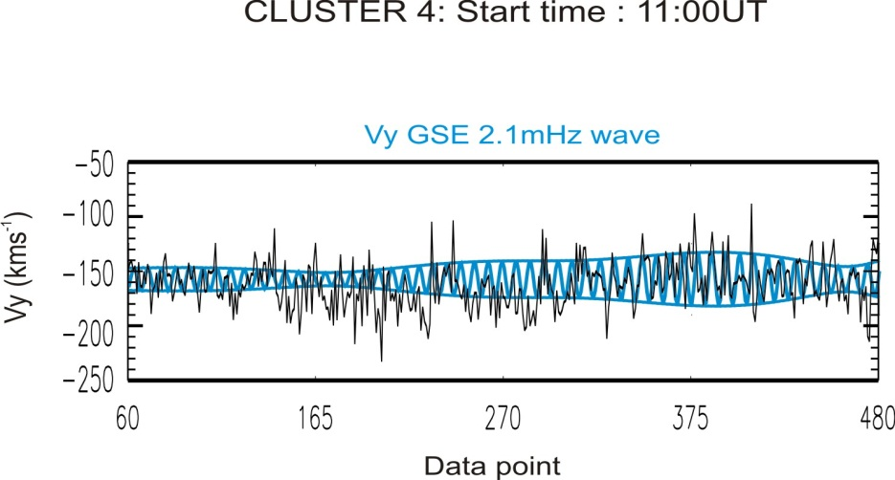
2.1 mHz MTM reconstructed signal
Instantaneous amplitude and phase of narrowband resonances determined by method of complex demodulation whereby data were bandpass filtered (in this analysis with the bandwidth of MTM) and an analytic signal was determined
Hanover, May/June 2011
Notes:
12

Slide 13
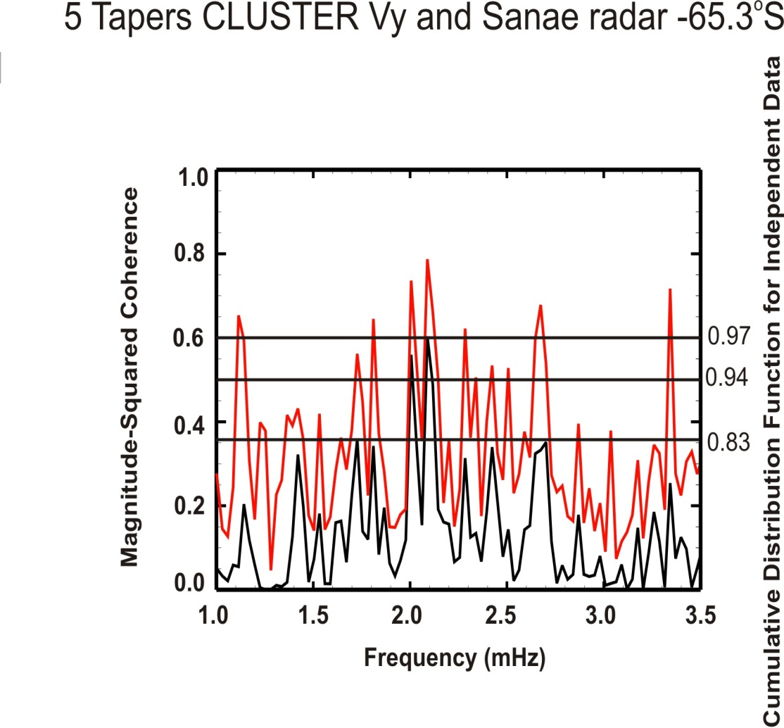
Coherence between CLUSTER and Sanae radar
The diagram shows the coherence of Cluster vy and Sanae Doppler velocity. In the 2.1mHz band it is significant at the 97% confidence level.
The work also showed that there was phase coherence between the signals.
Hanover, May/June 2011

Slide 14
Some Properties of MHD Waves
For β⟩1 four waves exist – fast and slow magnetosonic waves, transverse Alfvén and an entropy wave.
The magnetosonic waves have important contributions from the plasma and magnetic field pressure: the transverse Alfvén wave is incompressible
The fast wave is not highly anisotropic – it is propagated in all directions. Energy in the slow wave is propagated approximately along the magnetic field. Alfvén energy is propagated exactly along the magnetic field for all wave normal directions.
In a stationary medium the wave energy density is
And the wave flux vector is
In the solar wind the wave flux is
V is large enough so that the second term dominates

Slide 15
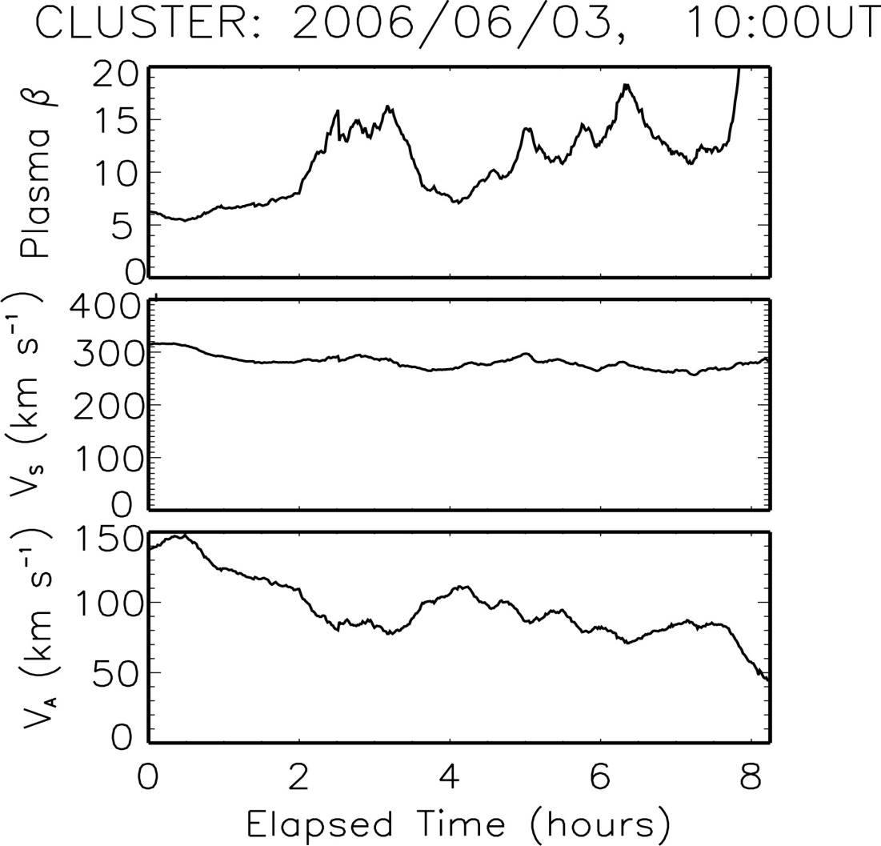
General conditions in the magnetosheath
Hanover, May/June 2011

Slide 16
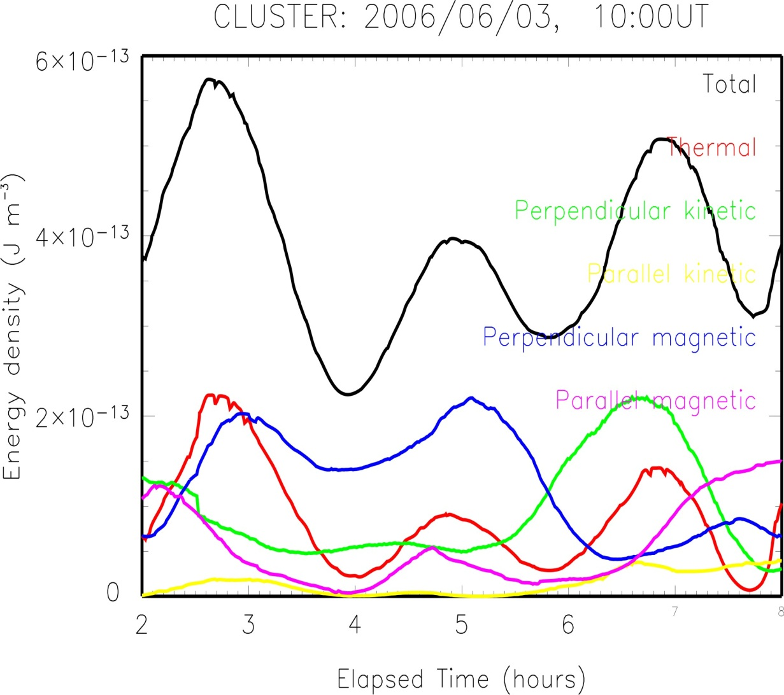
Contributions to 2.1mHz Wave energy density
Contributions from
perpendicular
magnetic and kinetic
are
ANTI-correlated
Hanover, May/June 2011

Slide 17
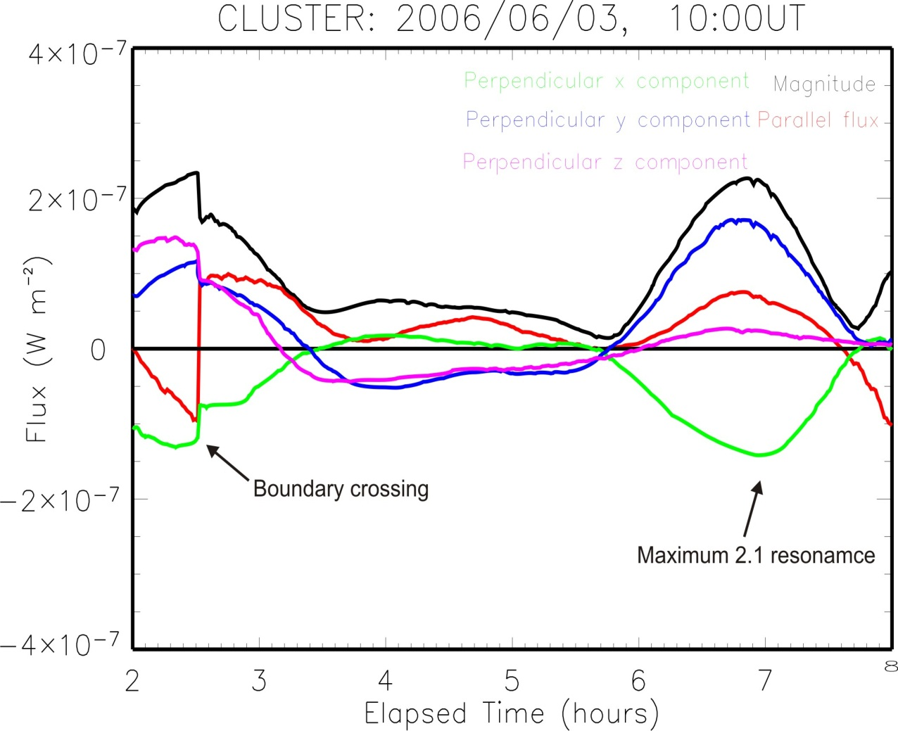
Energy flux in CLUSTER rest frame
Rest flux dominated
by perpendicular
components
Hanover, May/June 2011

Slide 18
Conclusions and future work
While we are NOT making the case that this is the only mechanism as the source of FLRs. On previous occasions, we have found discrete oscillations in the Pc5 band that exist in the solar wind are strongly correlated (both in phase and amplitude) with those observed in the magnetosphere. In this case study, they are also found in the magnetosheath.
We are performing an in-depth study of this wave in the magnetosheath in order to determine the nature of the wave.
Data from CLUSTER 1,2 and 3 spacecraft will be employed to determine further characteristics e.g. wavenumber of the resonance

Slide 19
Acknowledgements:
We thank members of the SSA-MTM team at the Department of Atmospheric Sciences, UCLA, US Geological Survey and Commissariat a l’Energie Atomique, as well as all other individuals responsible for the development and maintenance of the Toolkit used in the multitaper analysis presented here.
We thank members of the Cluster FGM team for supplying the Cluster data.
The SHARE radar is supported by the National Research Foundation of South Africa and Antarctic logistics are provided by the Department of Environment Affairs.

